Slide 1
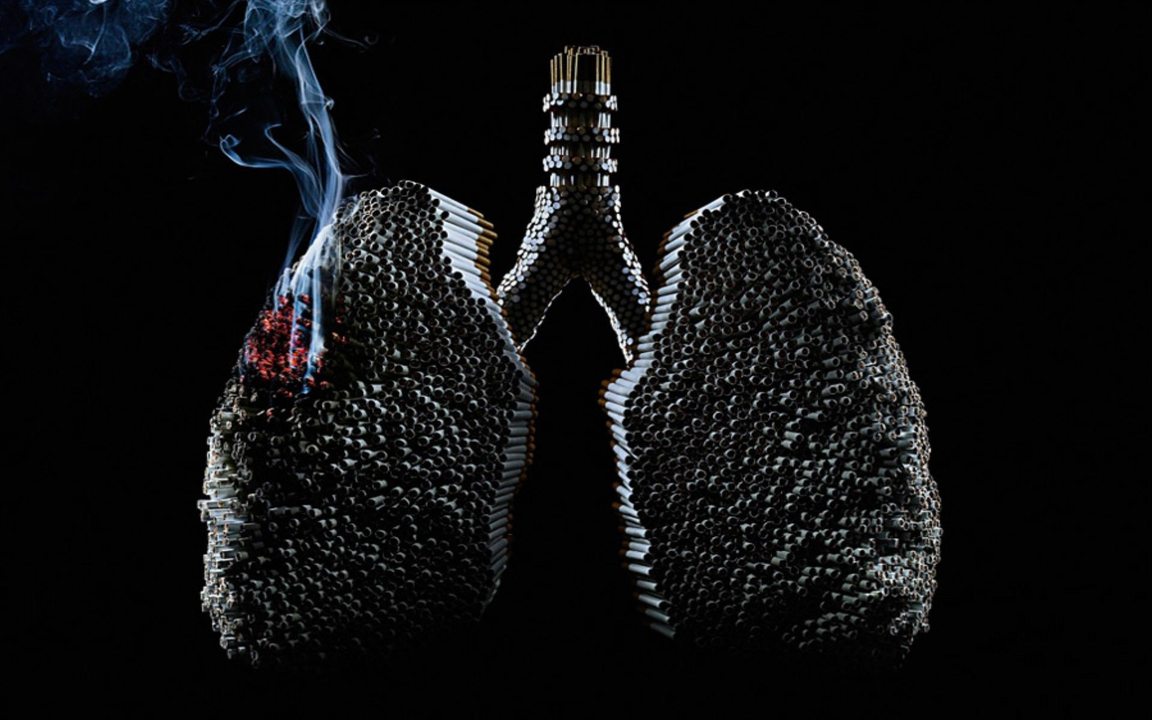
Be Smart. Don’t Start.

Slide 2
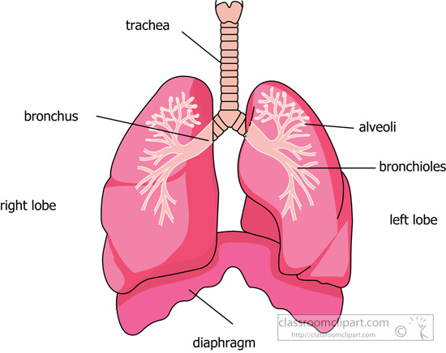

Slide 3
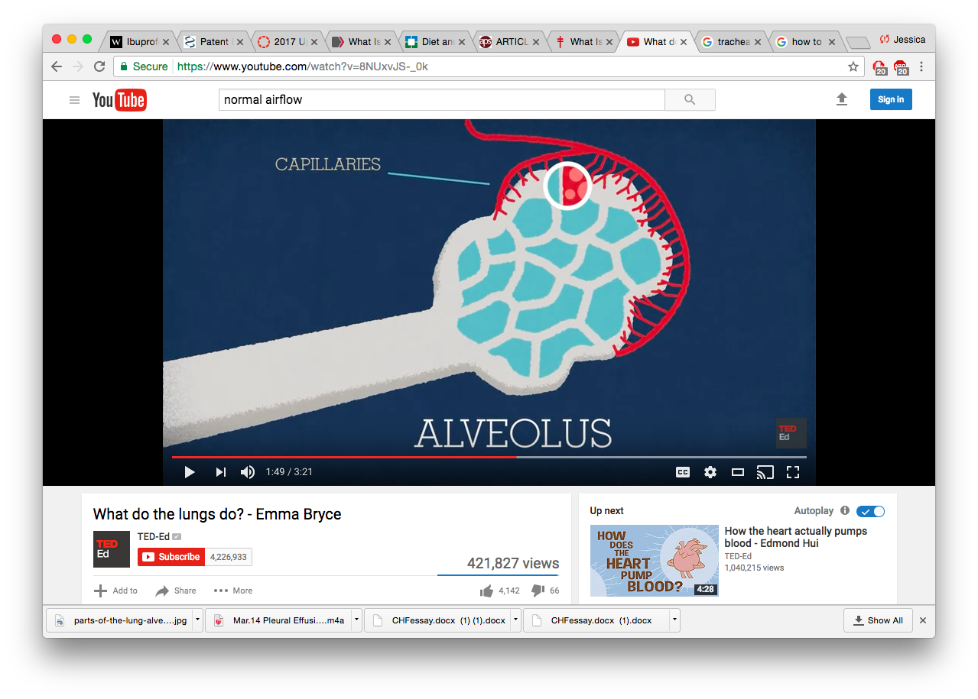

Slide 4
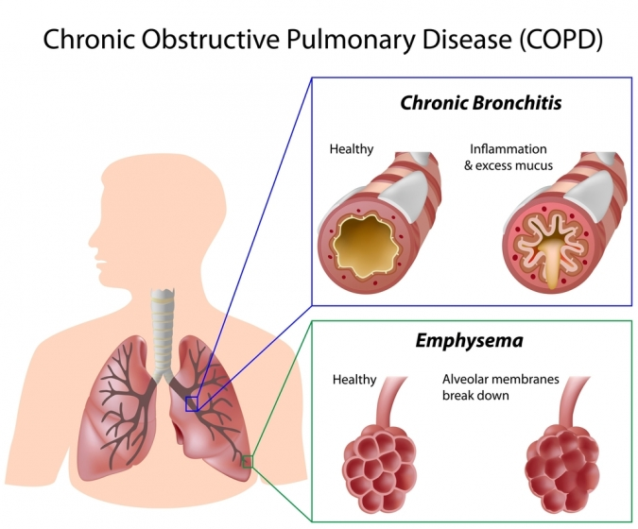

Slide 5
STRAW TEST!

Slide 6
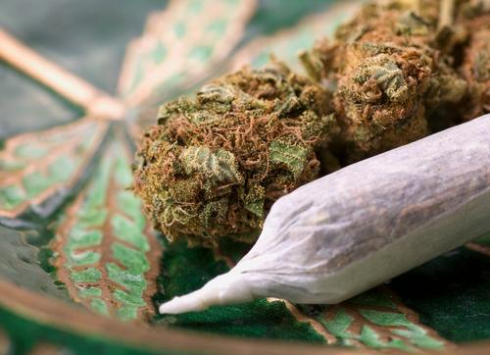
Marijuana Smoking

Slide 7
What is tar?
STICKY, BLACK substance from burning of tobacco and other plant material from the act of smoking

Slide 8
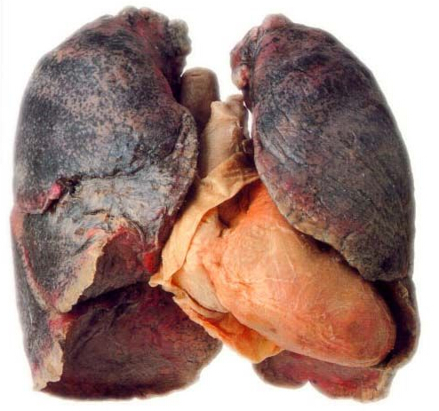
Cigarette Smoker’s Lung

Slide 9
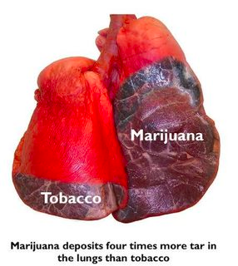
Marijuana deposits four times more tar in the lungs than tobacco

Slide 10
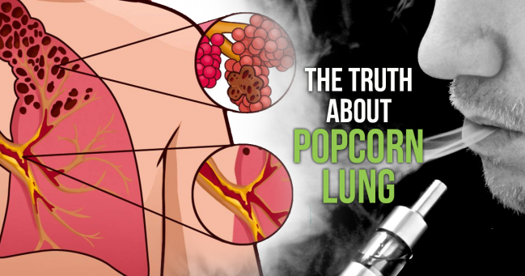

Slide 11
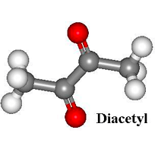
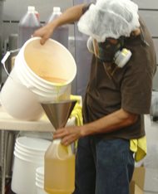
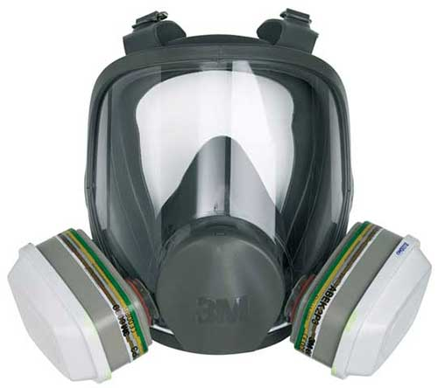
Diacetyl

Slide 12
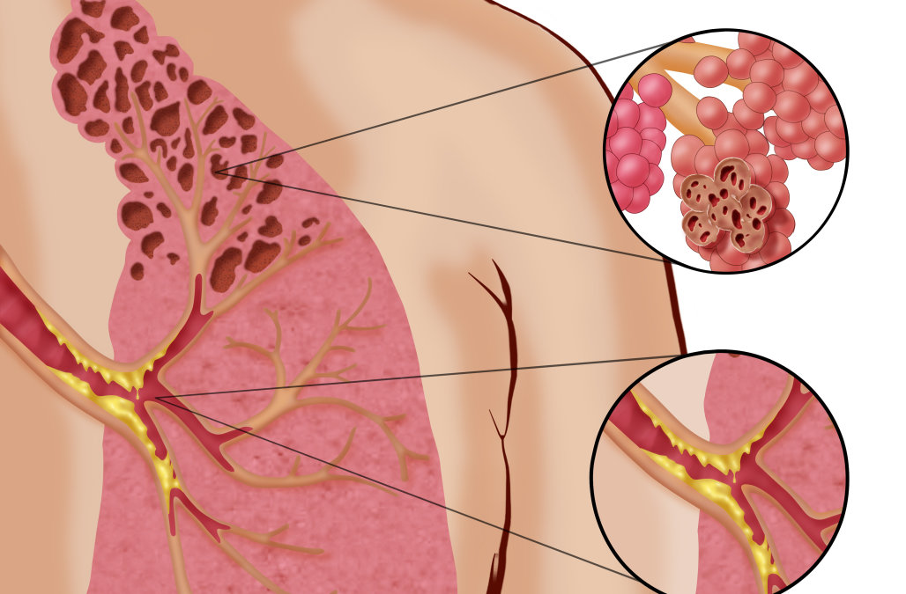
Bronchiolitis
Obliterans

Slide 13
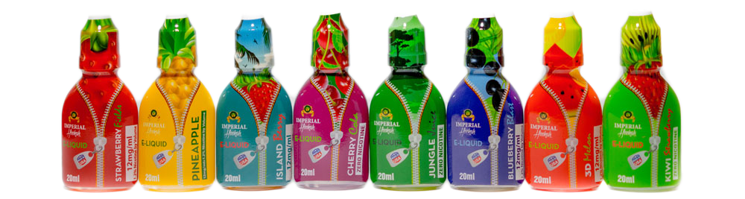
Safe for kids under 18?

